Slide 1
ME469: Nalu Overview
Stefan P. Domino^{1,2}
¹ Computational Thermal and Fluid Mechanics, Sandia National Laboratories
² Institute for Computational and Mathematical Engineering, Stanford
SAND2018-4536 PE

Slide 2
Lecture Objectives
Nalu Technology Origination: Advanced Simulation and Computing project (NNSA)
Beyond the 32-bit Limit
Supported Physics
Supported Numerics
Low- and High-order
Moving Mesh (Sliding and Overset)
Multiphysics
Fluid Structure Interaction
Conjugate Heat Transfer (CHT)
Participating Media Radiation
Examples

Slide 3
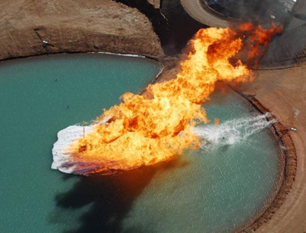
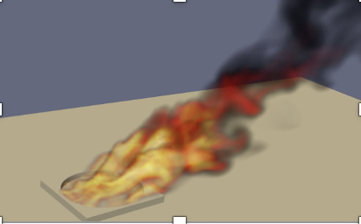
Core Technology Provided to Nalu Origination: Advanced Simulation and Computing Sierra/Fuego
Use-case characterized by a highly sooting, turbulent, reacting flow with Participating Media Radiation (PMR), Conjugate Heat Transfer (CHT), and propellant multi-physics coupling
Complex geometry has driven a generalized, hybrid unstructured discretization approach supporting Hex8, Tet4, Wedge6, and Pyramid5 elements in addition to promotion of Hex8 to Hex27, and Tet4 to Tet10

Slide 4
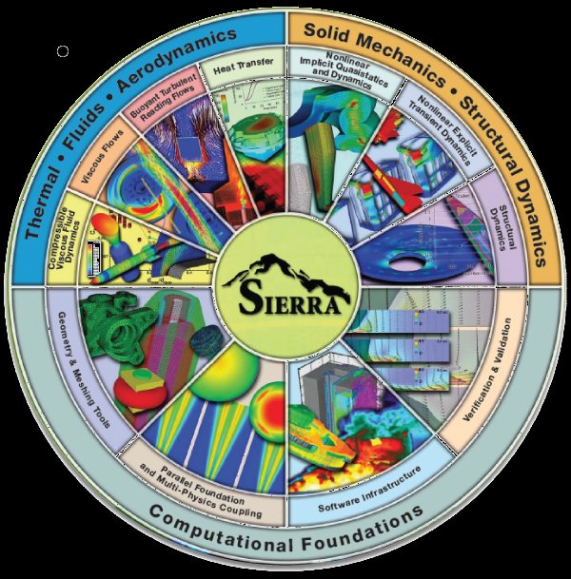


Goal: Beyond 32-bit Computing
Circa 2013, many scientific production codes were limited to 32-bit
Therefore, maximum simulation size for entities, e.g., node, edge, face, element, etc., was ~2.2 billion
Next Generation Platforms were advocated to overcome poor MPI scaling and power needs to support Exascale computing (10¹⁸ floating point operations/second)
Platform architectures, at that point, were not not yet known (still evolving)
+ ASC Investments
( )
Sierra Toolkit/Trilinos (open-source)
MPI+X parallelism
Support for new architectures

Slide 5
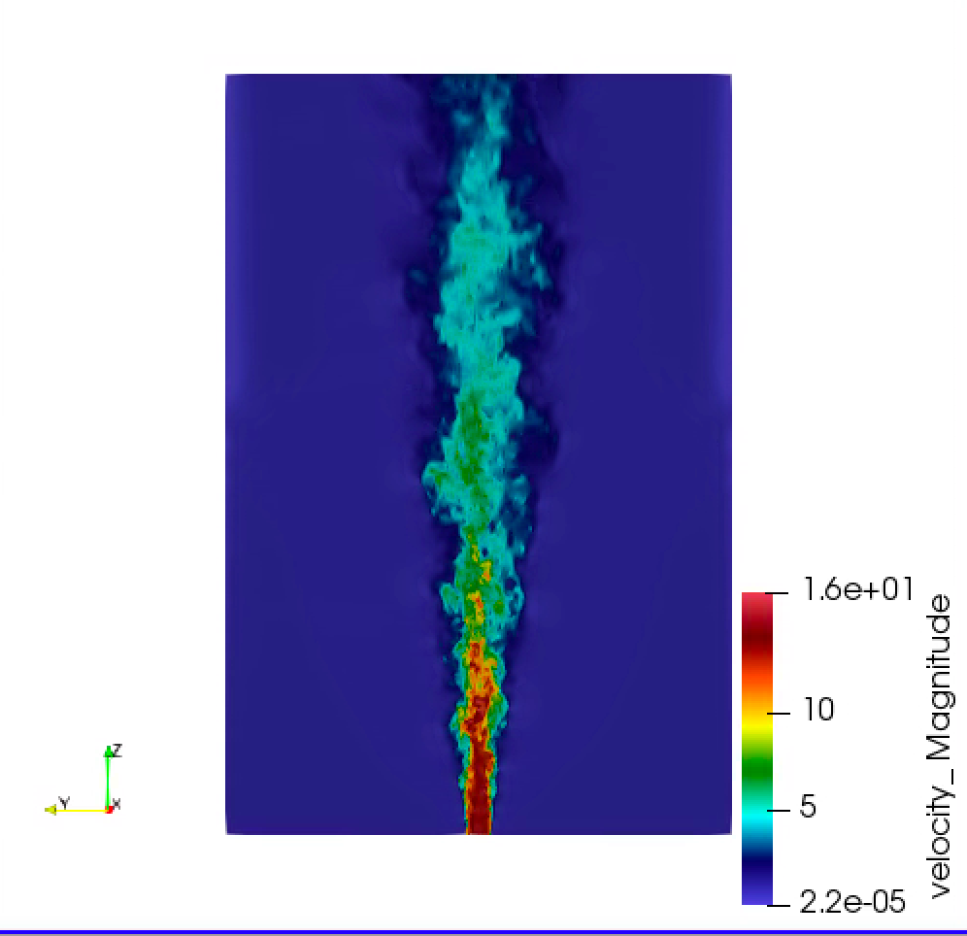


Developed Open-Source BSD-clause 3 Distribution Policy
Philosophy: Open-source collaborations
https://github.com/NaluCFD

Slide 6
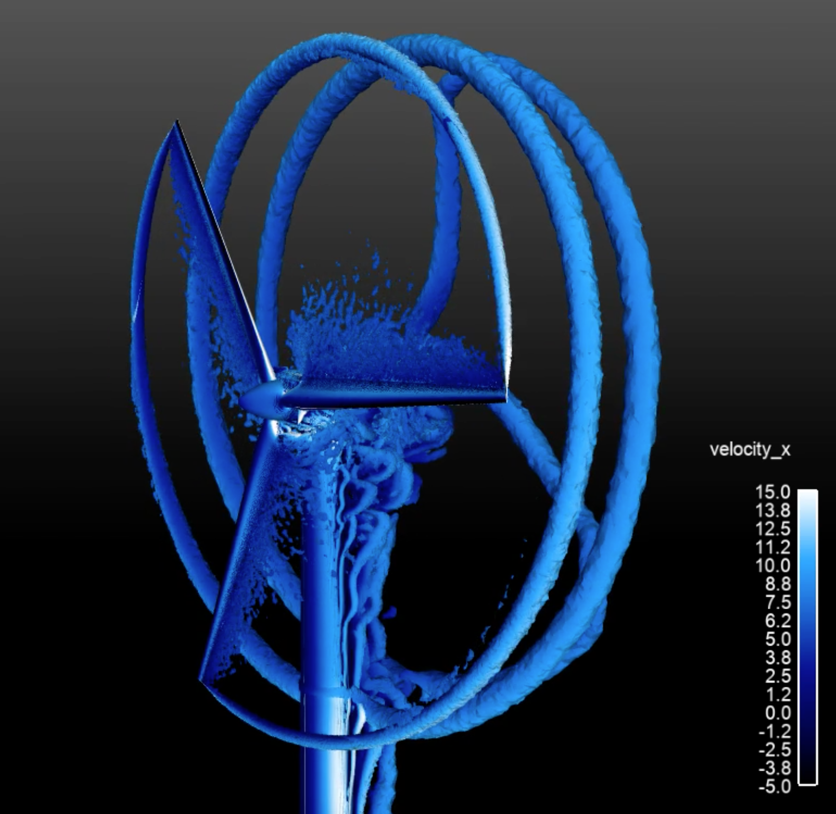
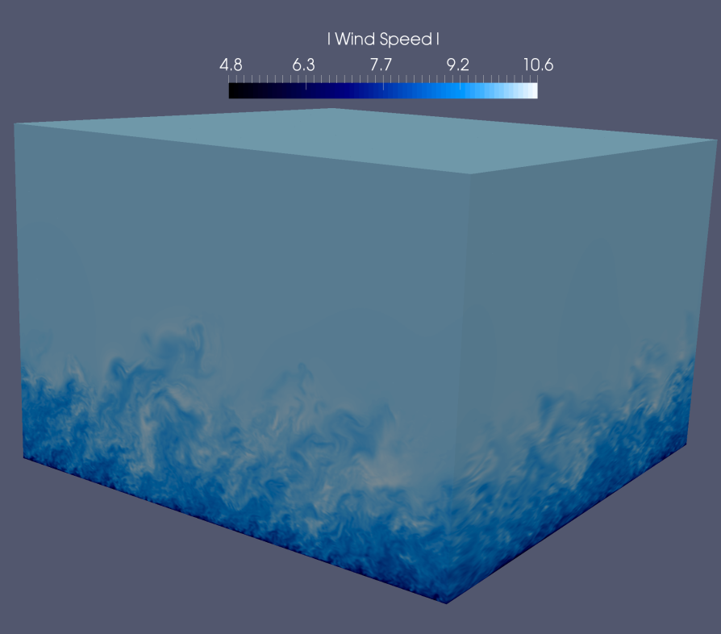
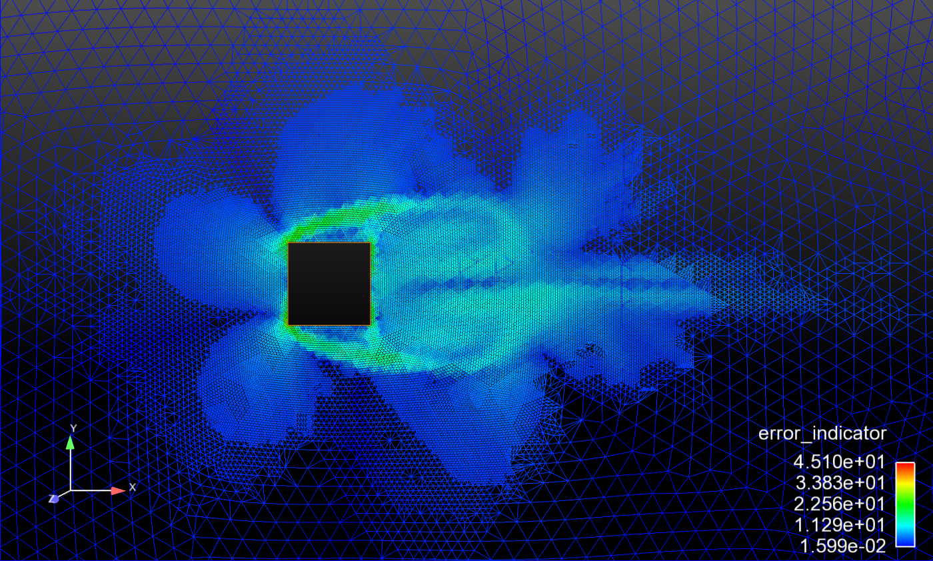
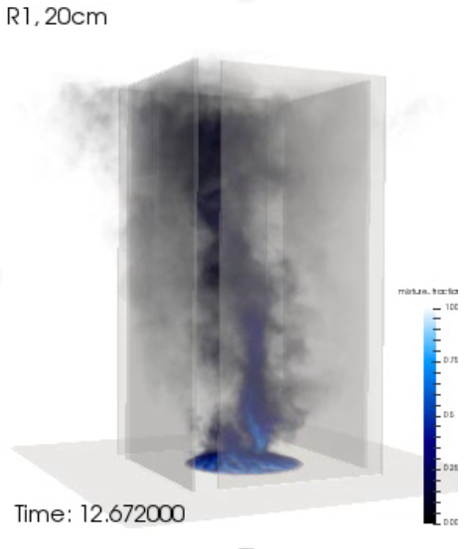
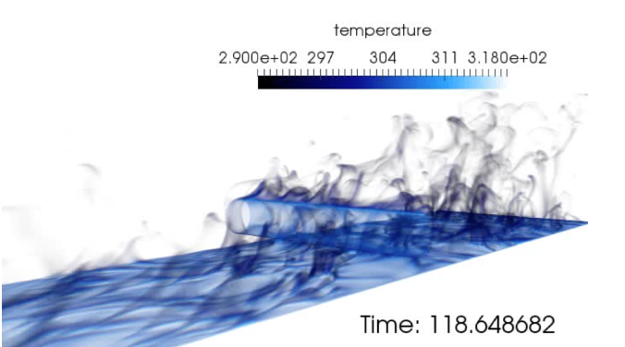
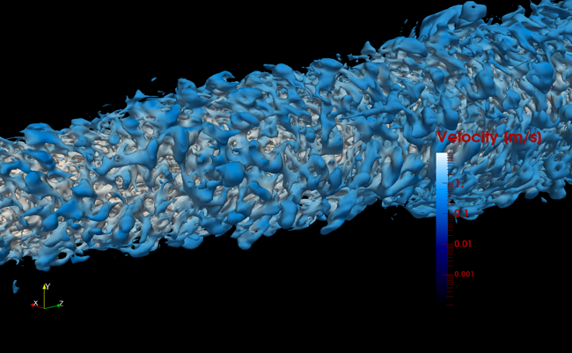
Supported Physics: DNS and LES (even RANS)

Slide 7
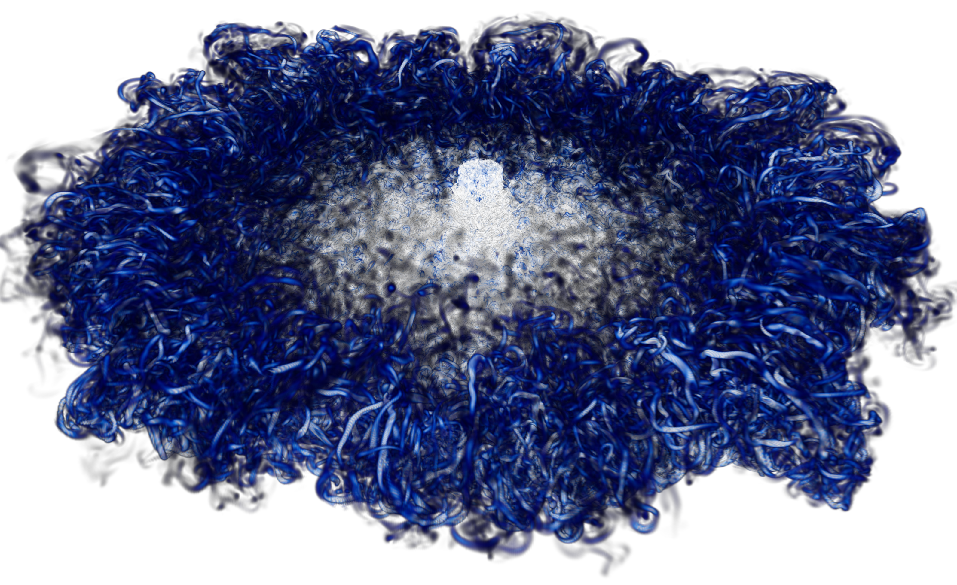
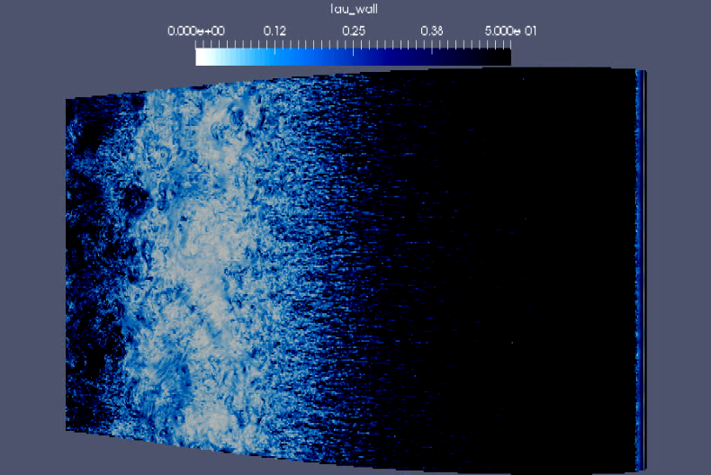
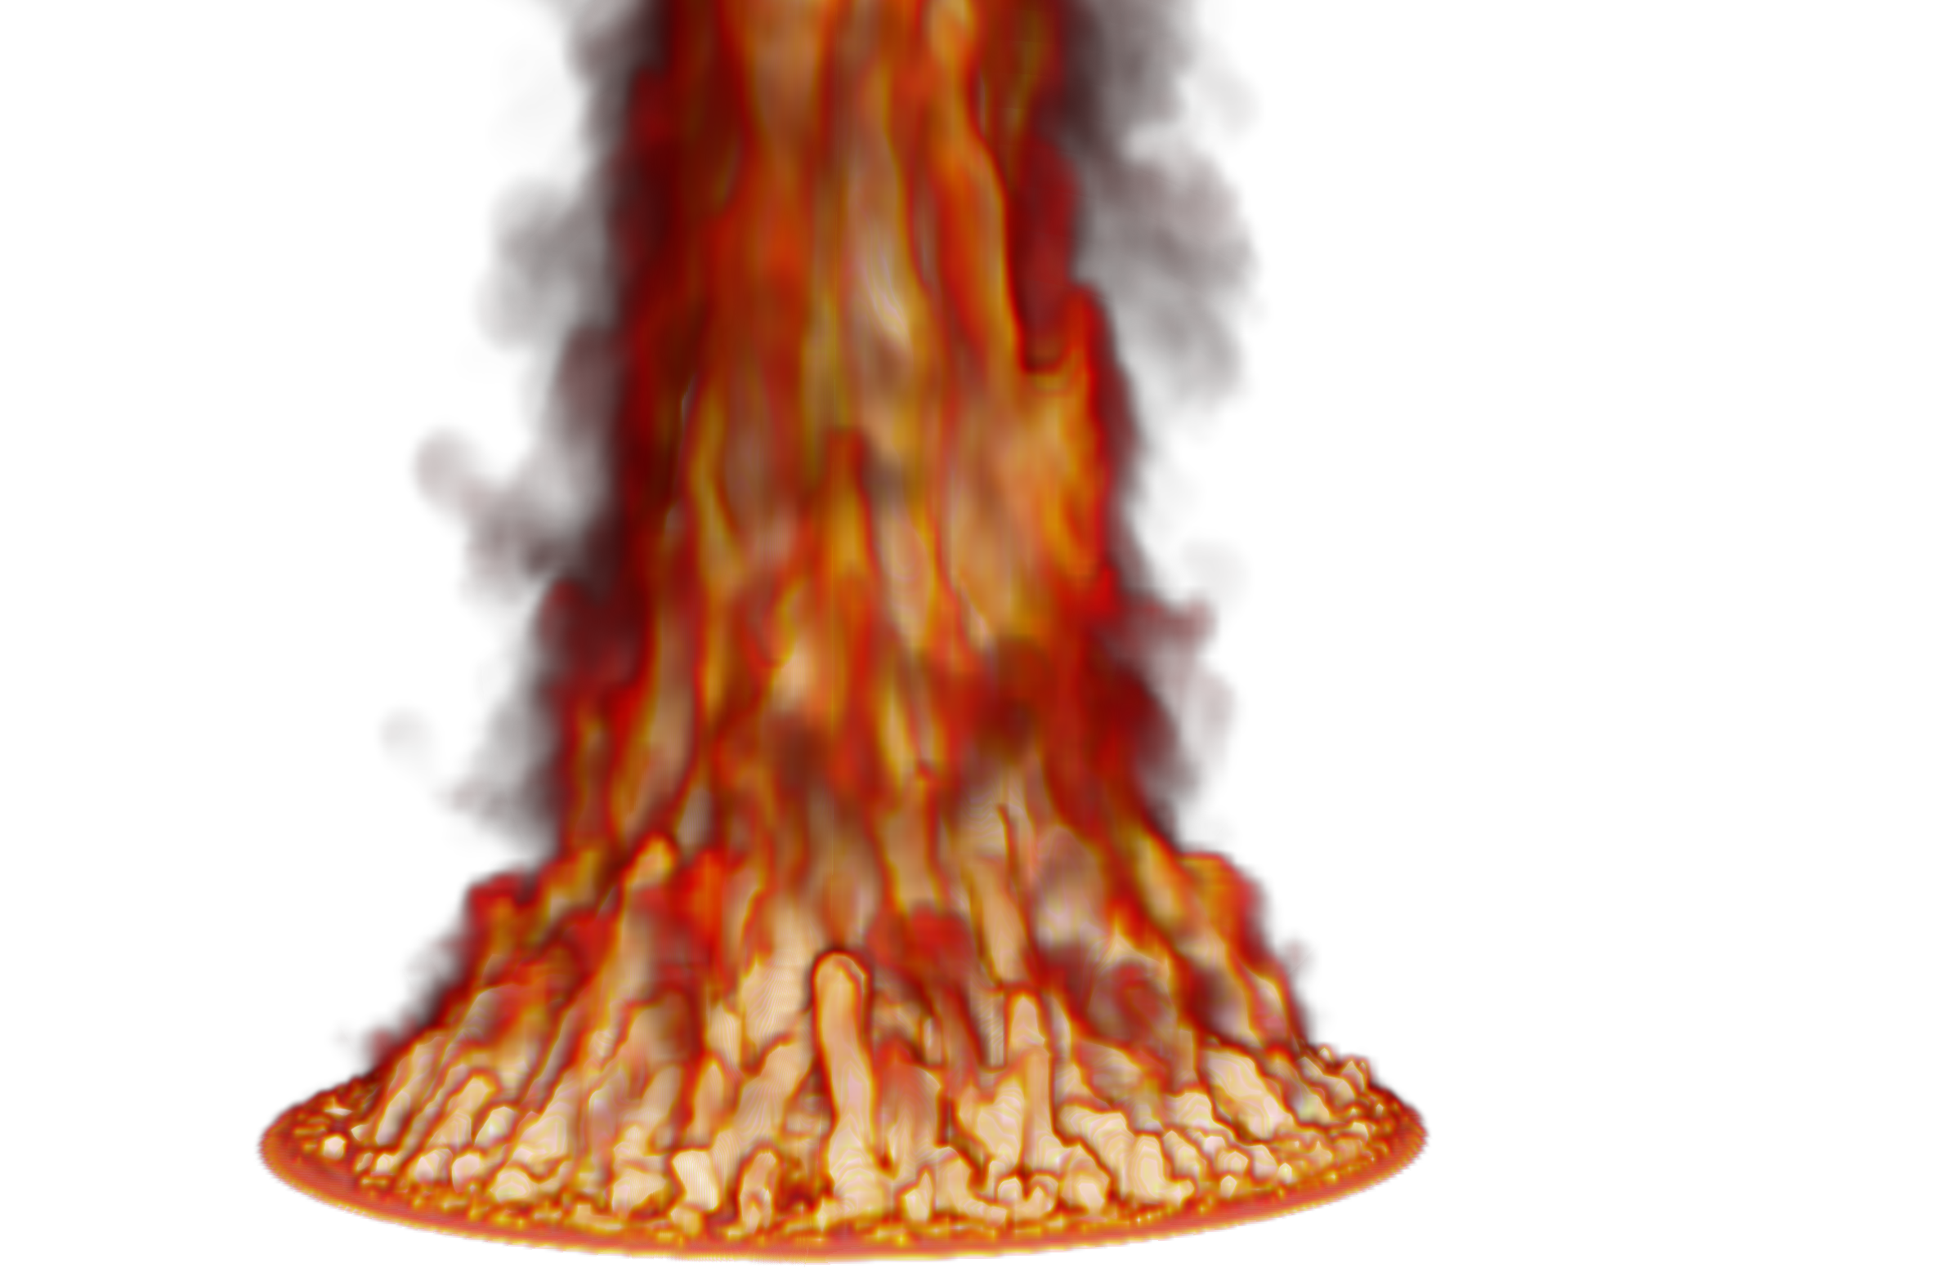
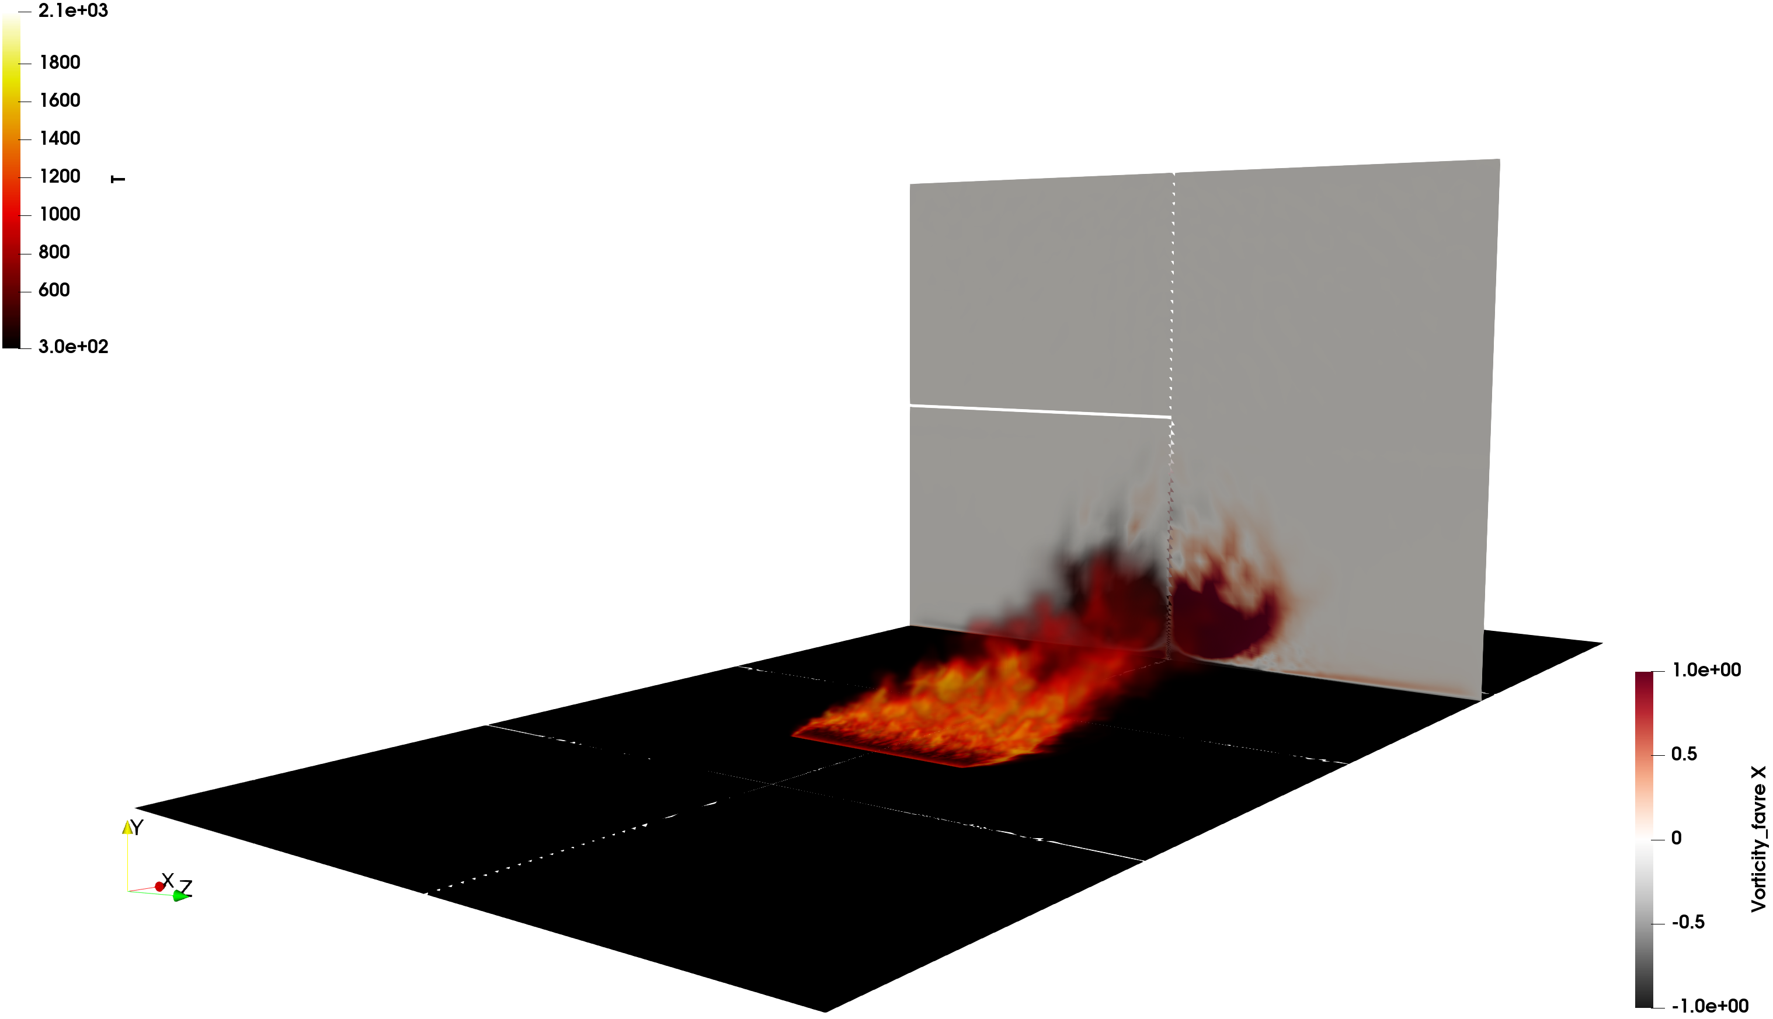

A Note on High Performance Computing
Sandia (and Stanford) are committed to High Performance Computing (HPC) to support is science and engineering objectives: Exercised herein
O(2) billion DNS impinging jet
O(6) billion wind energy application
O(200) million multi-physics fire

Slide 8
Nalu Timeline/History
By CFD standards, this is a relatively new code base
Sierra/Nalu
SNL License
Open-source
BSD License (2014)
Github
Nalu
…. etc
Active
academic partners
ECP ExaWind (2018)
Github
Nalu-Wind
Open-source: SNL, NREL, ORNL, UT joint copyright

Slide 9

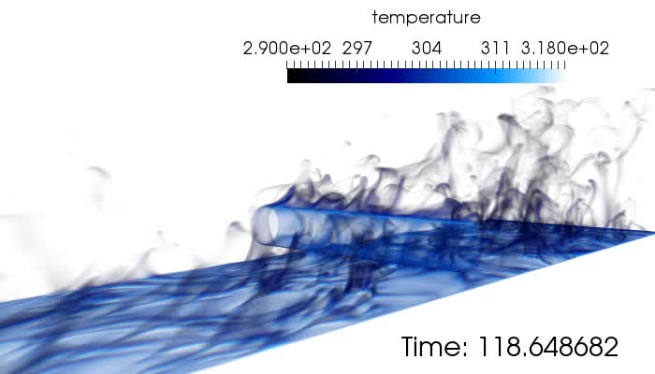
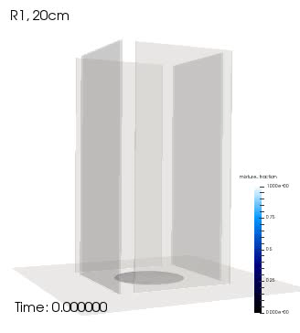
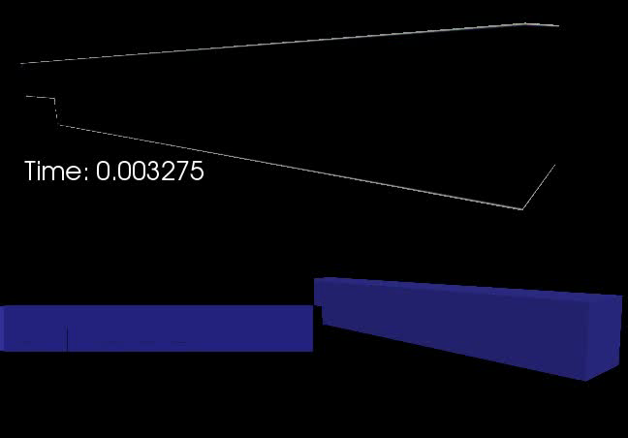
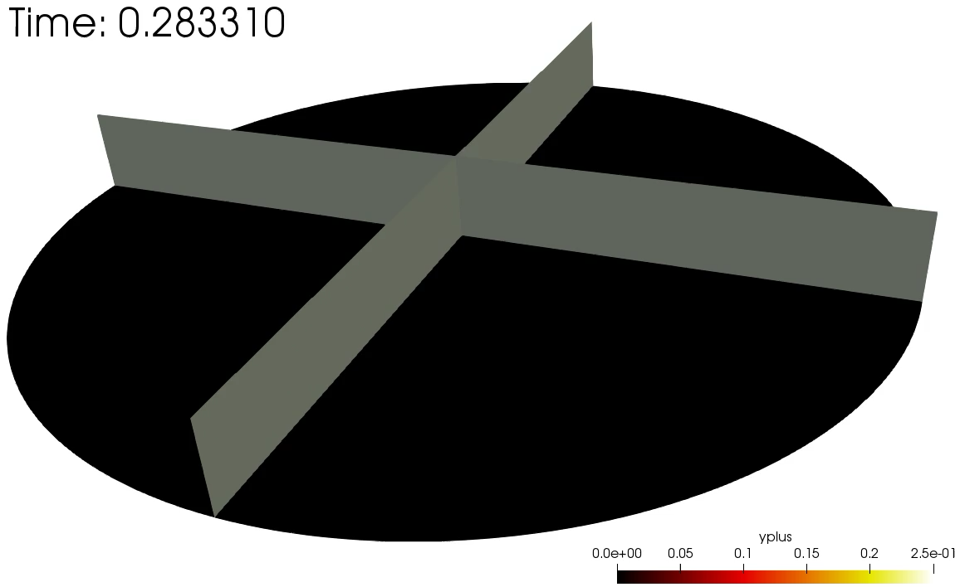
Several Multi-physics Flow Examples From Nalu
Cylinder in cross flow
Helium plume (low-/high-order)
Heated backstep
Whirling behavior
Impinging Jet DNS

Slide 10
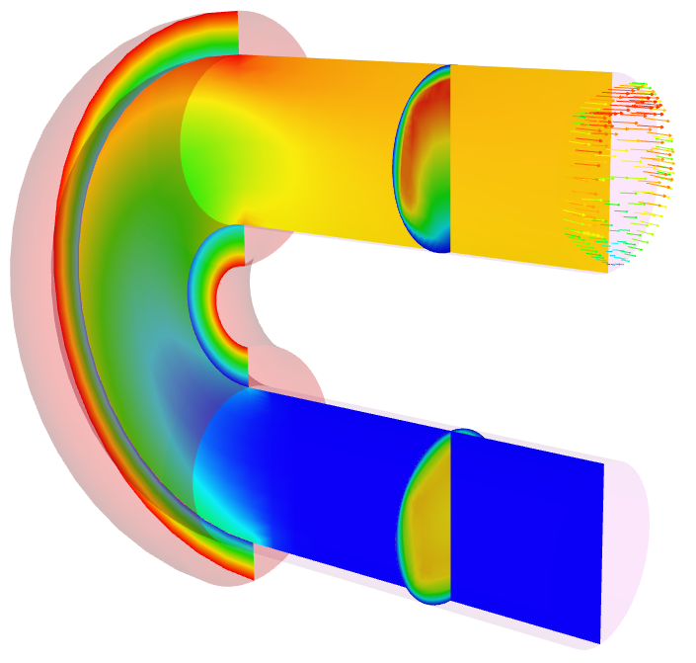
Nalu Abstractions: Polymorphic and Input File-Driven
Operator-split multi-physics
Conjugate heat transfer coupling
Fluids Realm
Heat Conduction Realm
Time Integration
Nonlinear Coupling
Domain
Realm A
Realm B
1 to many
Interior
algorithms
1 to many
Interior
algorithms
1 to many
boundary
algorithms
1 to many
boundary
algorithms
Transfer
Realm specifications define the physics and desired boundary conditions
Pre-defined EquationSystems (segregated or monolithic)
Operator-split multi-physics:
Conjugate heat transfer coupling
Fluids and solid Realm

Slide 11
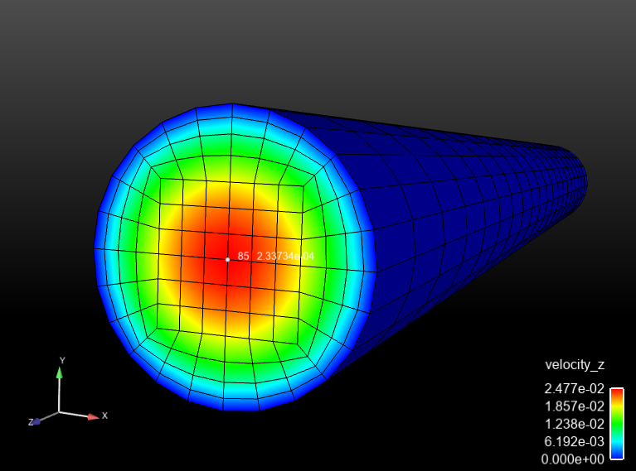
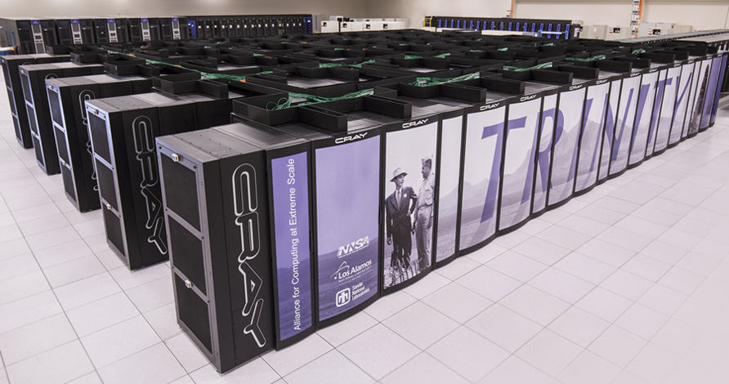


Essential Attributes of a CFD Simulation
Mapping from Real World, to Conceptual Model, and, finally, a Computer Model (given an underlying PDE discretization approach)
Input File(s)
Mesh
mesh: my_mesh.g
euations: my_equations
- inflow_boundary_condition: bc_left
target_name: Inflow
velocity: [1.0,0.0]
mixture_fraction: 0.0
Hex8
Tet4
launch remotely
launch locally
output.log
output.e.32.*
output.rst.32.*
Remote Viz
>scp output.e.32.* /to/my/local/disk

Slide 12
30K View: Anatomy of a Nalu Input File:YAML-based
Simulation:
linear_solvers:
transfers:
realms:
- name: realm_heatCond
boundary_conditions:
- wall_boundary_condition: bc_exposed
solution_options:
initial_conditions:
material_properties:
equation_systems:
systems:
- HeatConduction:
output:
restart:
- name: realm_fluids
TimeIntegrators:
Specification of sparse Trilinos-based precond/solver
Data transfer for multi-physics coupling
YAML enforces strict spacing and ordering
https://www.democraticunderground.com/10021540110
Physics definitions
Time integration, e.g., BE, BDF2

Slide 13
High-Level Elements of an Input File
systems:
- LowMachEOM:
name: myLowMach
- MixtureFraction:
name: myZ
initial_conditions:
- constant: ic_1
target_name: [block_1, …]
value:
pressure: 0
velocity: [0.5,0.0]
mixture_fraction: 0.0
boundary_conditions:
- inflow_boundary_condition: bc_left_inflow
- wall_boundary_condition: bc_front_wall
- open_boundary_condition: bc_right_open
- symmetry_boundary_condition: bc_top
- nonconformal_boundary_condition: bc_nc
material_properties:
target_name: block_1
specifications:
- name: density
type: constant
value: 1.0
- name: viscosity
type: constant
value: 1.8e-5
material_properties:
target_name: block_1
specifications:
- name: density
type: ideal_gas
- name: viscosity
type: polynomial
coefficient_declaration:
- inflow_boundary_condition: bc_left
target_name: surface_1
inflow_user_data:
velocity: [0.5,0.0,0.0]
mixture_fraction: 0.0
- wall_boundary_condition: bc_back
target_name: surface_7
wall_user_data:
user_function_name:
velocity: wind_energy
user_function_string_parameters:
velocity: [mmTop_ss7]
mixture_fraction: 1.0

Slide 14
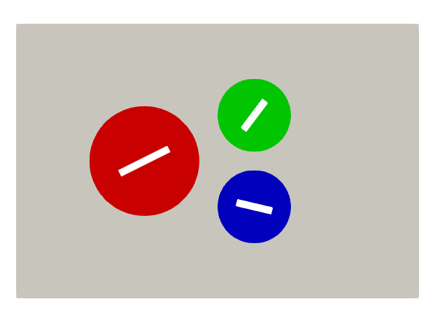
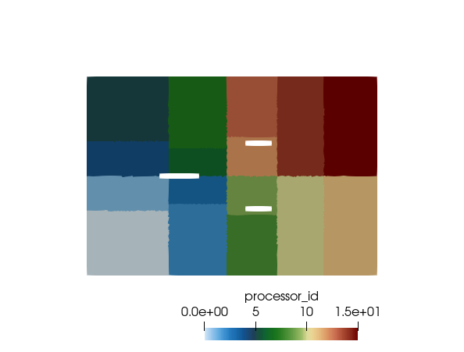
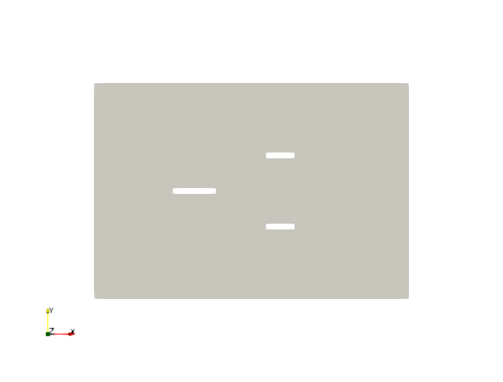
A Note on Parallel Decomposition
Decomposing the mesh into small subsets and operating on these subsets in parallel provides a methodology for increased simulation time
Colored by block ID
Colored by core count (= 1) One mpi rank. 16 MPI ranks = 16x faster (hopefully)

Slide 15
How to Run in Parallel: Mesh Decomposition
Given a mesh, mesh.g and myInputFile.i, if one desires to run on, e.g., 16 core case:
Use pre-processing “decomposition” tools (Trilinos/install/bin)
In-situ decomposition
>/path/to/decomp –j {np} {meshName}
>mesh.g.16.00, mesh.g.16.01, .., mesh.g.16.15
1:
- name: realmFluids
mesh: mesh/myMesh.g
automatic_decomposition_type: rcb
myMesh.g
- name: realmFluids
mesh: mesh/myMesh.g
automatic_decomposition_type: rcb
2:
>mpirun --np 16 /naluPath/naluX -i input.i &
>results.e.16.00, results.e.16.01, .., results.e.16.15
>input.log

Slide 16
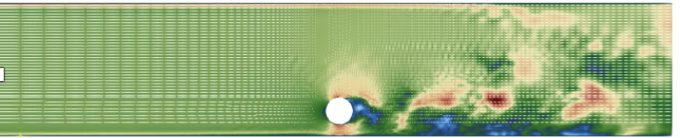



A Note on Divergence
Whether by design or poor code usage, solution results from CFD analysis for complex applications may diverge. How do I know?
Non-finite residuals, i.e., not-a-number:“nan” (either linear or non-linear),
const double norm = 0.0;
const double flux = rho*u*A/norm;
What if the simulation runs, however, results look very wrong? Typical causes?
Bad initial condition that drives nonlinear solution to diverge
Too large of an initial time step
Poor stabilization, numerical parameters, etc.
Poor time integration
Ph.D. from ICME explaining why…
EBVC flow-past 2D cylinder
Top: +NOC
Bottom se: -NOC

Slide 17
Test Case Input Files
Input files are part of the Nalu regression test suite: Nalu/reg_test/test_files
Mesh files are found under: Nalu/reg_test/mesh
Formally, /mesh is a git submodule
Test Cases Highlighted:
Nalu/reg_tests/test_files/dgNonConformalThreeBlade
Nalu/reg_tests/test_files/fluidsPmrChtPeriodic
Resource: https://nalu.readthedocs.io/en/latest/source/theory/index.html

Slide 18
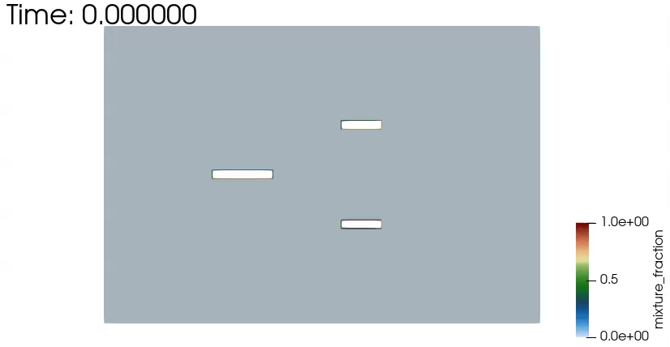
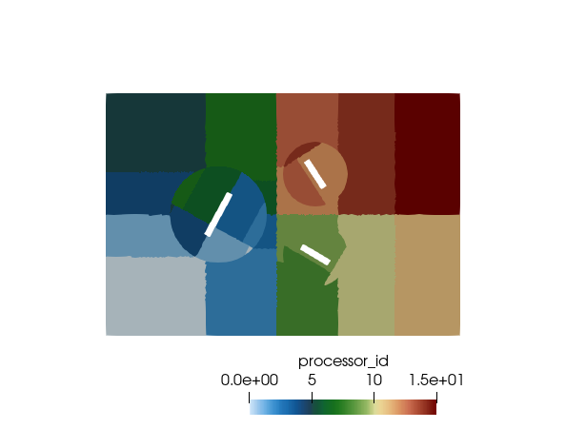
Nalu/reg_tests/test_files/dgNonConformalThreeBlade
Physics:
Flow past rotating square blades (Re = 10,000)
Models
Newtonian fluid (air) with constant properties
Boundary Conditions
Inflow, open, symmetry, DG/CVFEM interface
Domino, JCP, 2018
>mpirun --np 4 /naluPath/naluX -i dgNonConformalThreeBlade.i &

Slide 19
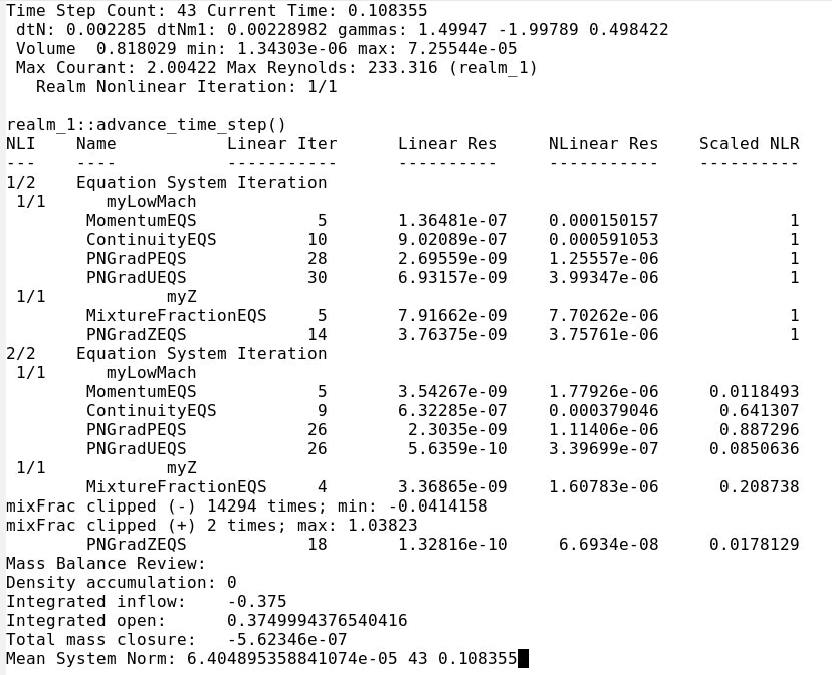
Nalu/reg_tests/test_files/dgNonConformalThreeBlade
γ_{i} for BDF2
UΔt/Δx
ρ U L / μ
Nonlinear
iterations
Equations
Review

Slide 20
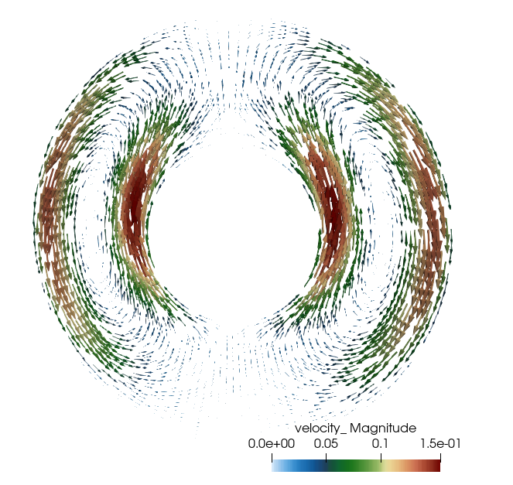
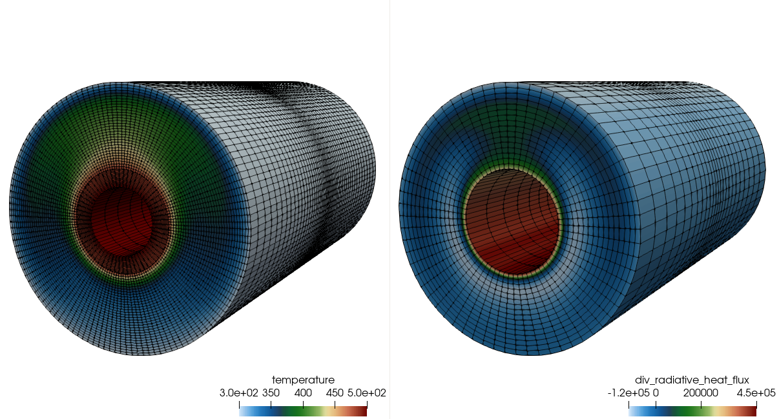
Nalu/reg_tests/test_files/fluidsPmrChtPeriodic
Physics:
Uniformly emitting/absorbing participating media radiation (PMR) conjugate heat transfer (CHT) with buoyancy
Models:
Newtonian fluid (air): ideal gas
Boundary Conditions:
Wall, periodic
Stark#, cond/rad
Sk = λ μ / σ T_{i}³ ~ 0.4
Rayleigh#, τ^{ThermalDiff}/ τ^{Conv}
Ra = g β (T_{i} – T_{o} ) L / Pr α² ~ 2e6
>mpirun --np 8 /naluPath/naluX -i fluidsPmrChtPeriodic.i &

Slide 21
Nalu/reg_tests/test_files/fluidsPmrChtPeriodic
Temperature
Irradiation
Conduction
Heat Transfer,
Enclosure Radiation
SURFACE
Participating
Media
Radiation DOM
STK
Transfer
Temperature, μ_{g}
RTE Src
Linearized
Temperature
Convection Coef.
Reference Temp
SURFACE
۰q_{r}
VOLUME
Δ
Turbulent
Fluid Mechanics,
Combustion
Monolithic, i.e., fully coupled, approaches are intractable due to the size of (u, v, w, p, h, h^{r}, Z, I^{k} T)^{T}
Stable and accurate operator split methods are, therefore, sought
See Domino et al., AIAA, 2007

Slide 22
Break-out Example Using Paraview
Live demo

